Slide 1
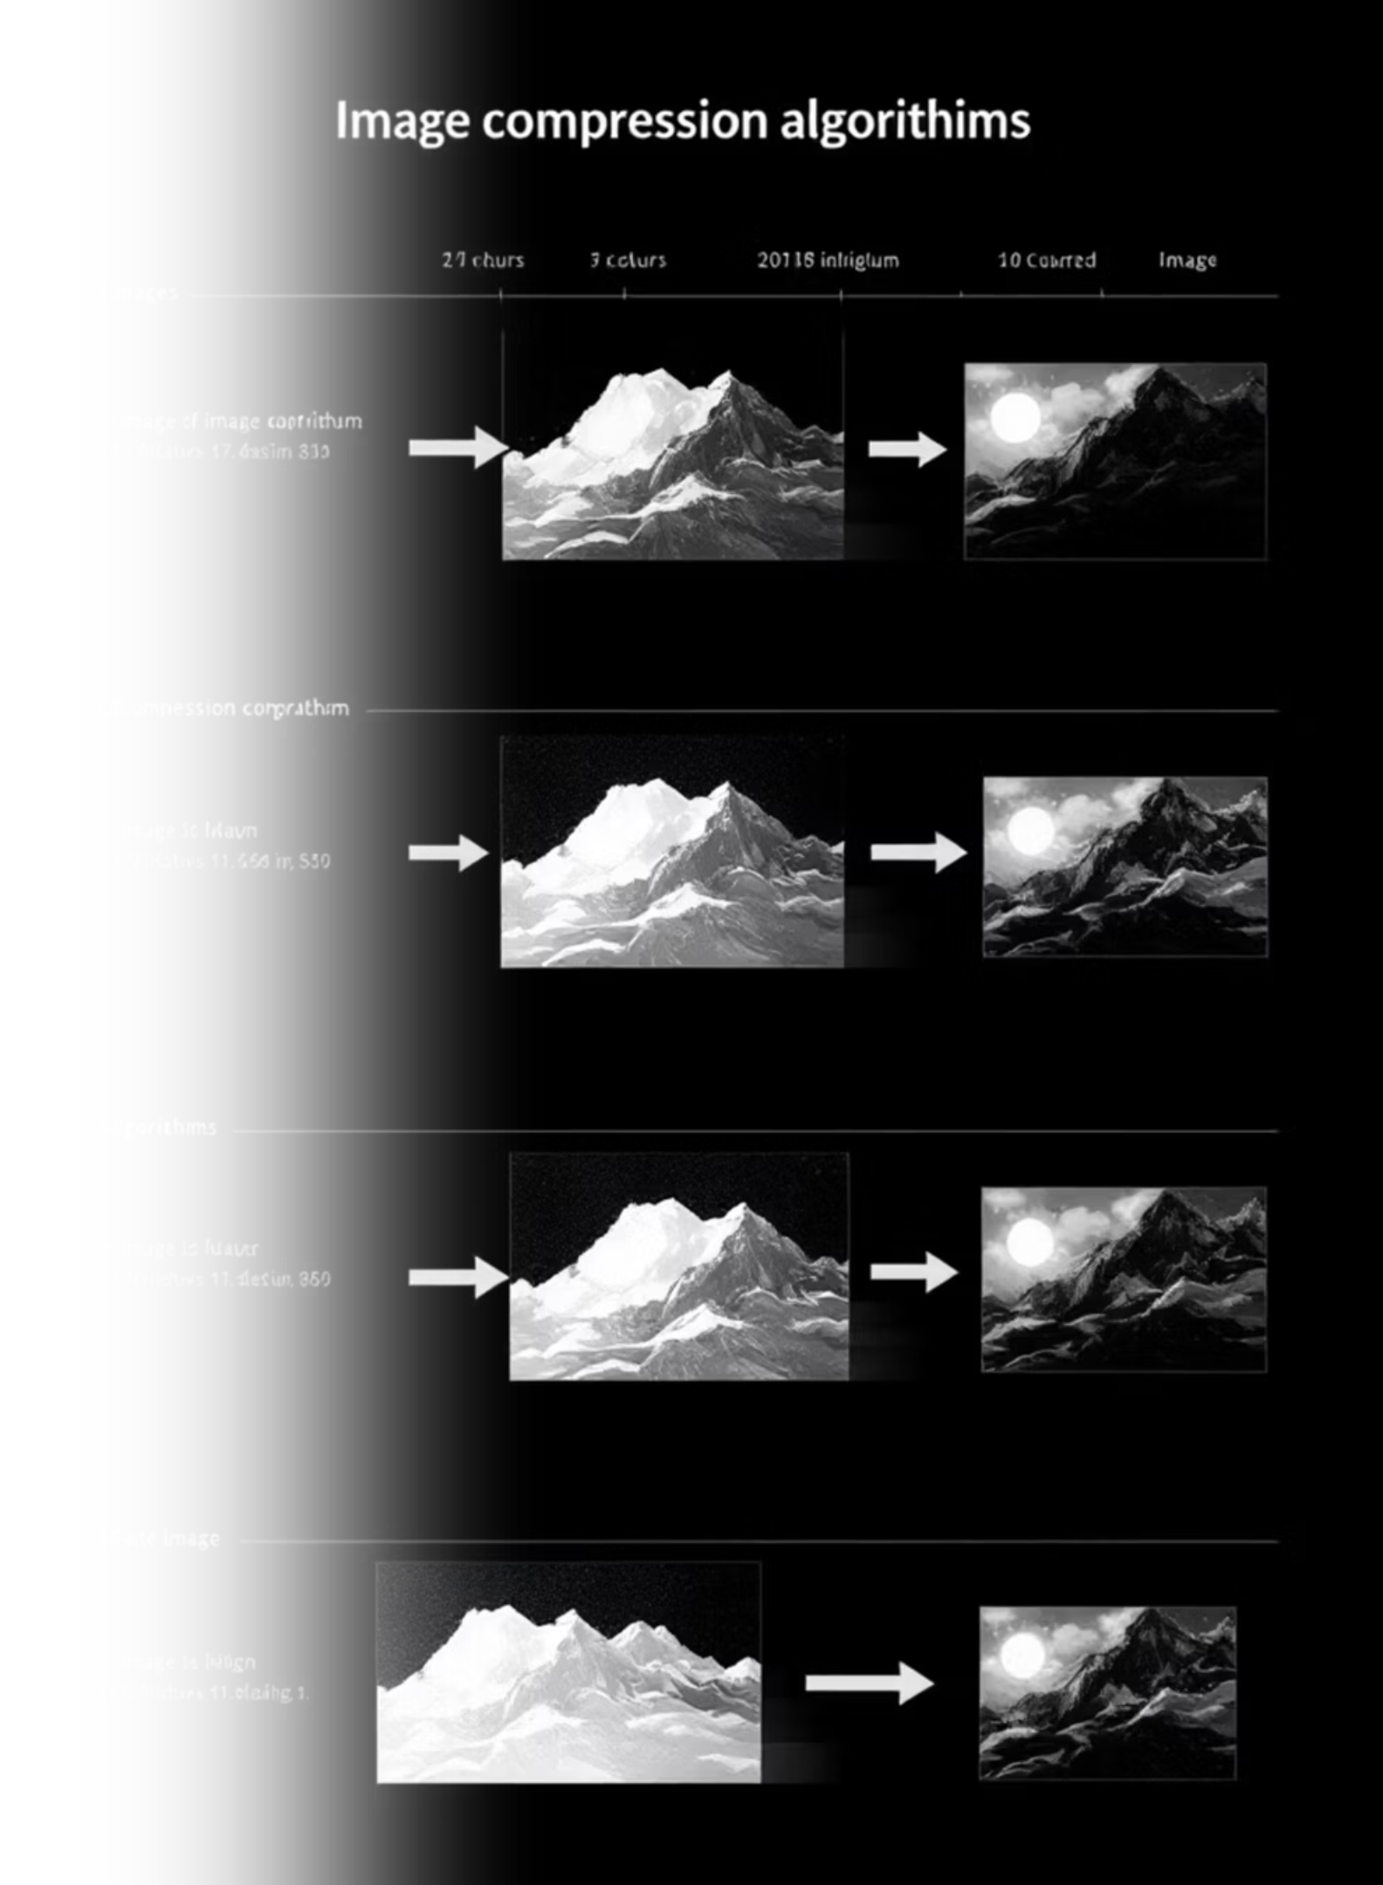
CompVis: Image Compression Comparison
Exploring and comparing various image compression algorithms to understand their impact on file size, visual quality, and objective metrics.
By Rahaf Ibrahim Under supervision of Dr. Majdi Msallam

Slide 2
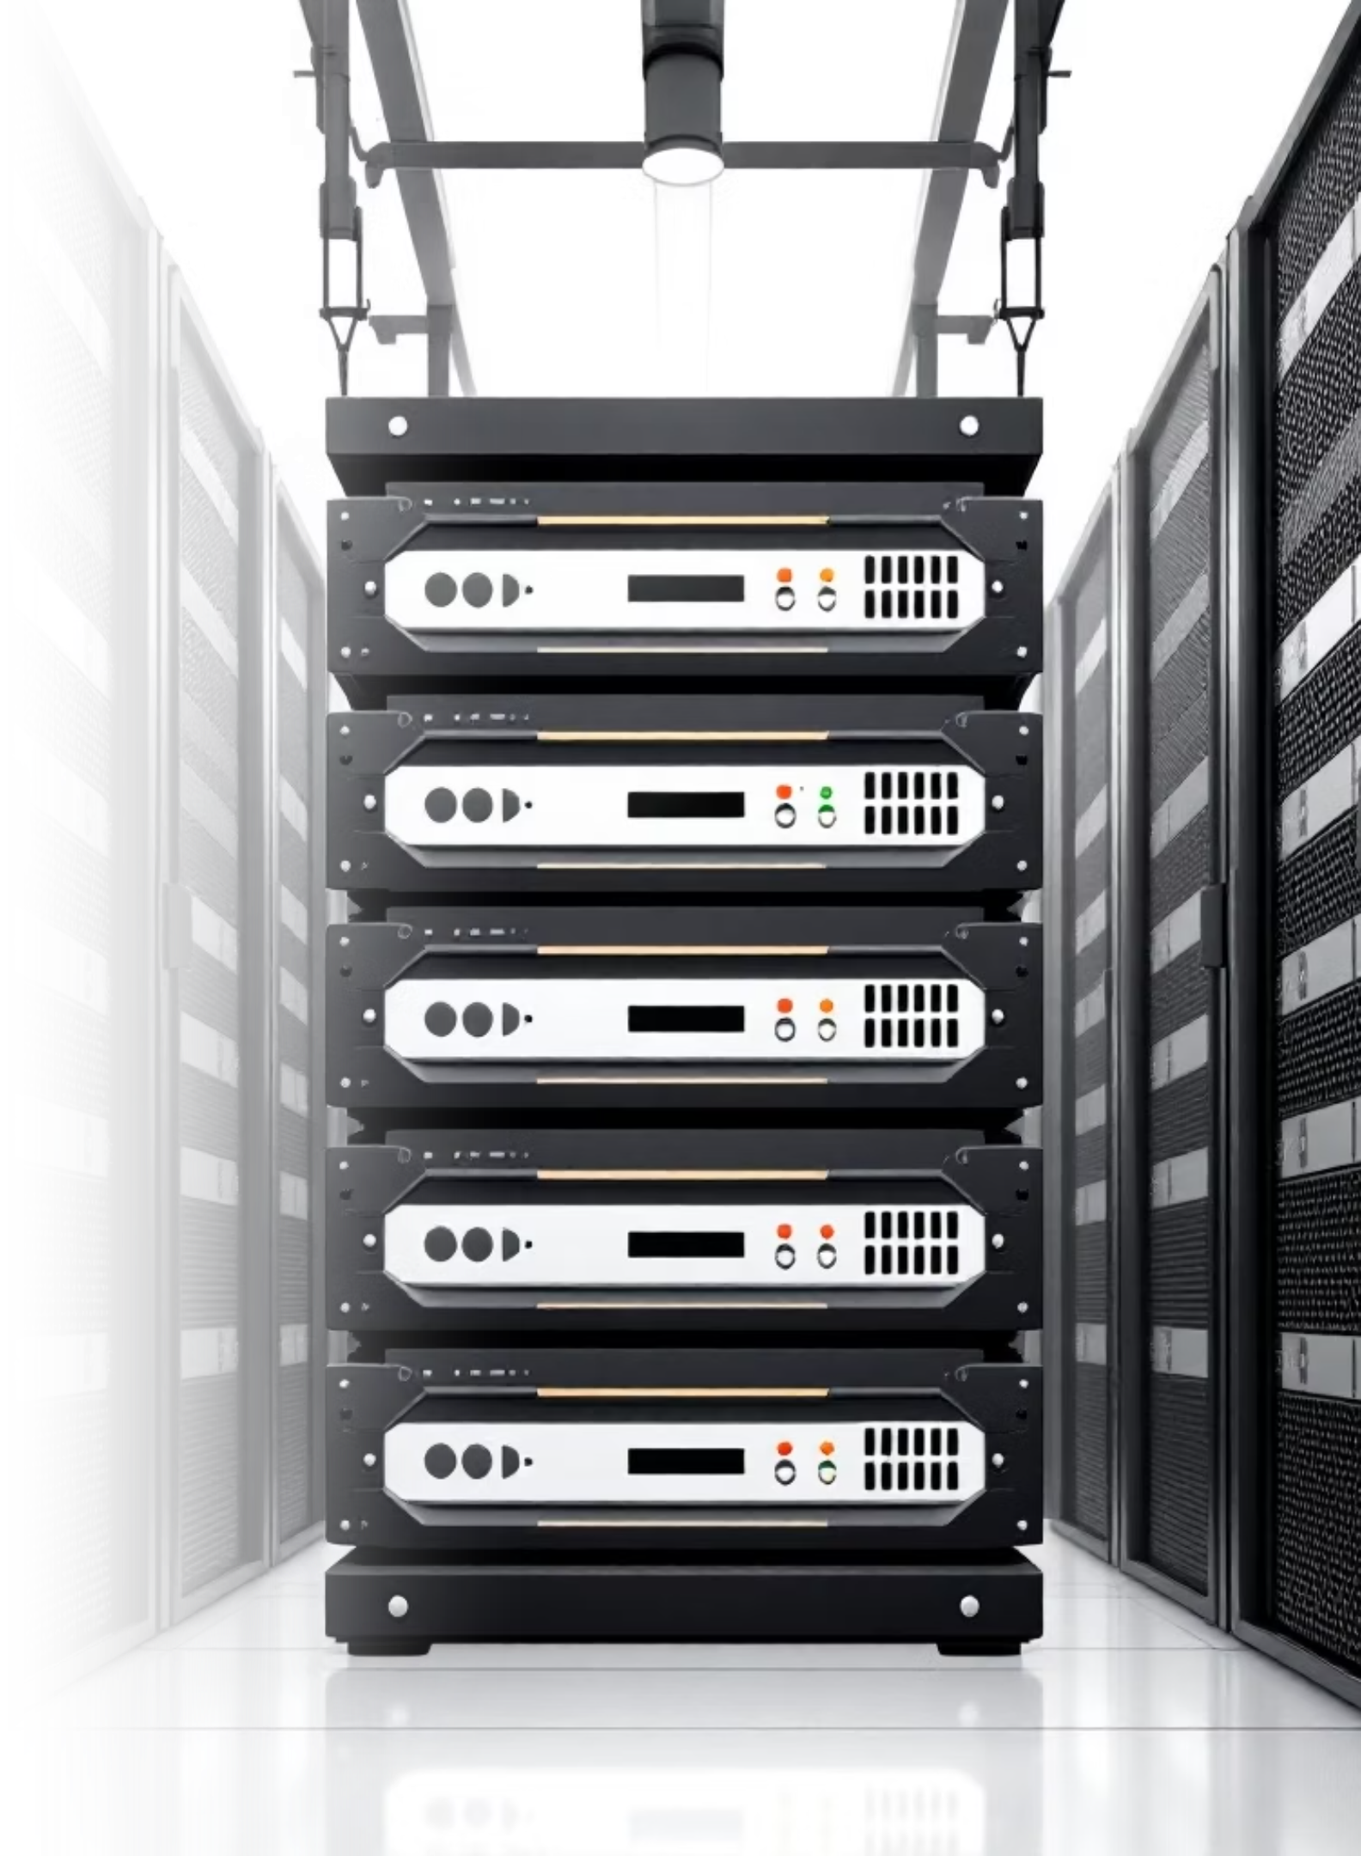



The Challenge of Image Compression
File Size
Reducing storage and bandwidth requirements.
Visual Quality
Minimizing perceptible distortion for the human eye.
Performance
Balancing compression efficiency with processing speed.

Slide 3
Lossy vs. Lossless Compression
Lossy Compression
Lossless Compression
Permanently removes data by discarding information the human eye is less likely to notice.
Preserves all data by finding patterns and creating efficient encoding. The process is completely reversible with perfect reconstruction.
Compression Ratio
Compression Ratio
20-50%
70-90%
Best For:
Best For:
Text, logos, and graphics
Photographs and complex images
Technical drawings and screenshots
Web content and social media
Images requiring transparency
Mobile applications
Trade-off: Acceptable quality loss for significant size reduction
Advantage: Perfect quality preservation
Artifacts: Blocking, blurring, mosquito noise at high compression
Limitation: Larger file sizes, less effective for photos

Slide 4




Supported Compression Algorithms
JPEG (Lossy)
WebP Lossy
Standard for photographic images, offering adjustable quality and file size.
Google's modern format, often providing better compression than JPEG at similar quality levels.
WebP Lossless
PNG (Lossless)
Preserves all original image data, similar to PNG, but often with smaller file sizes.
Ideal for graphics with sharp edges and transparent backgrounds, ensuring no data loss.

Slide 5
Technology Stack & Dependencies
Streamlit
PIL/Pillow
NumPy
Web framework enabling rapid development of data applications with automatic state management and reactive updates
Python Imaging Library providing extensive image format support and efficient pixel manipulation
Numerical computing library enabling efficient array operations for image data processing
Key Features: Auto-reruns, widget state caching, wide layout support
Usage: Image loading, format conversion, codec-specific saving
Usage: Pixel array conversion, difference image calculation
scikit-image
Matplotlib
os and pathlib
Image processing library providing industry-standard quality metrics (PSNR, SSIM) implementations
Plotting library for creating rate-distortion visualizations and scientific charts
For file handling and paths.
Metrics: PSNR with data_range=255, SSIM with channel_axis=2
Output: BPP vs. PSNR scatter plots with codec labeling

Slide 6
Understanding the Interface: Key Features
1
User Upload
2
Quality Control
3
Parallel Processing
User uploads image via sidebar file uploader.
Quality slider (10-95) sets compression parameters for lossy codecs. Default: 75
System processes image through 4 codec pipelines simultaneously
Storage: Temporary directory
Affects: JPEG and WebP lossy compression only
Codecs: JPEG, WebP lossy, WebP_lossless, PNG
4
Metrics Calculation
5
Results Display
6
Interactive Analysis
For each codec: file size, BPP, PSNR, SSIM, and difference images are computed
4-column layout shows compressed images, metrics, and download buttons
Rate-distortion plot and summary table
Export: Download any compressed image

Slide 7
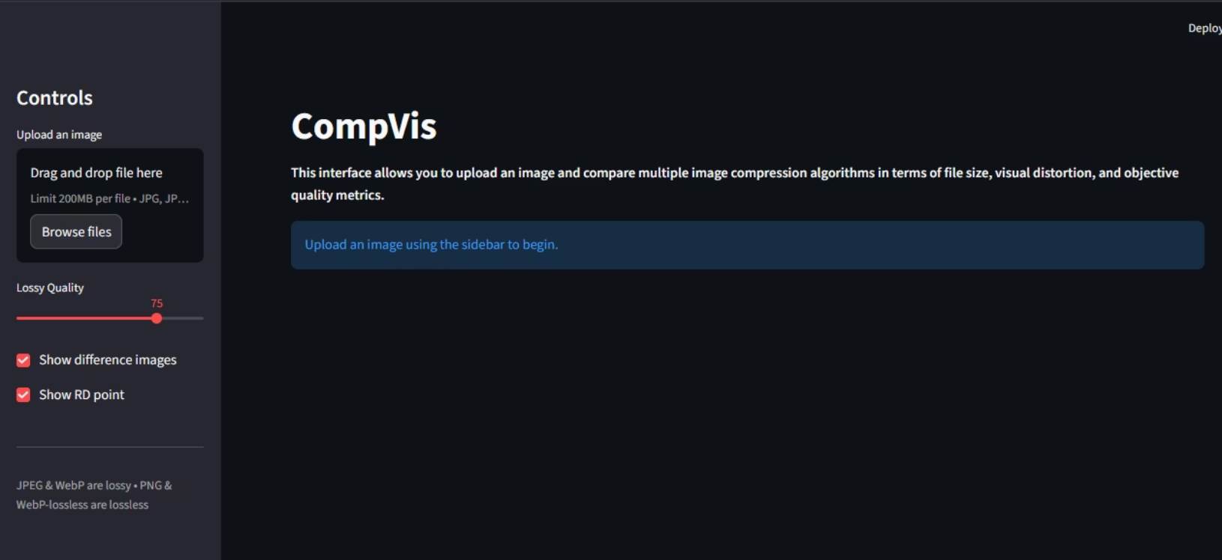
Understanding the Interface: Key Features

Slide 8
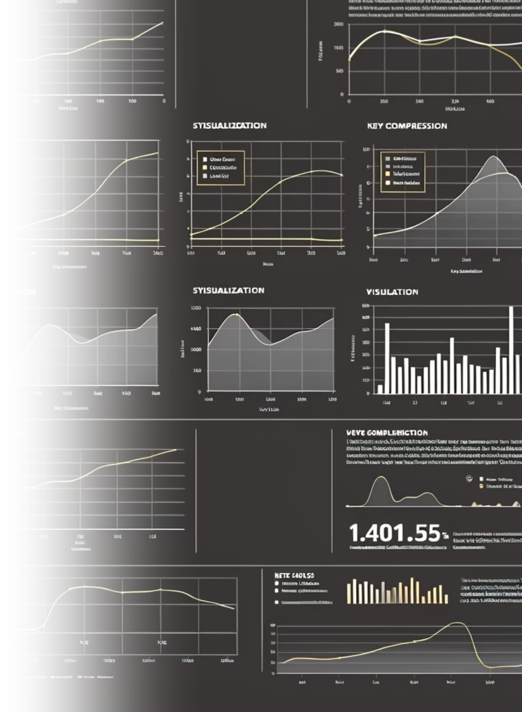

Objective Quality Metrics
PSNR (Peak Signal-to-Noise Ratio)
SSIM (Structural Similarity Index Measure)
Measures the fidelity of the compressed image compared to the original, with higher values indicating better quality.
Evaluates perceived change in structural information, brightness, and contrast, often aligning better with human perception.
BPP (Bits Per Pixel)
Indicates the average number of bits used to represent each pixel, directly correlating with file size efficiency.

Slide 9
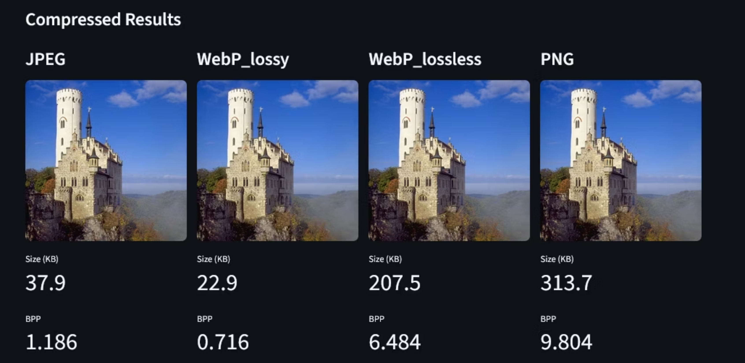
Visual Comparison of Compressed Images

Slide 10

Detailed Compression Results
For each codec, the application provides a concise summary of its performance.
Key Metrics Displayed:
Size (KB): The final file size after compression.
BPP: Bits per pixel, indicating data density.
PSNR (dB): Objective quality score, higher is better.
SSIM: Perceptual quality score, closer to 1.0 is better.
Users can also download each compressed image for further analysis or use.

Slide 11
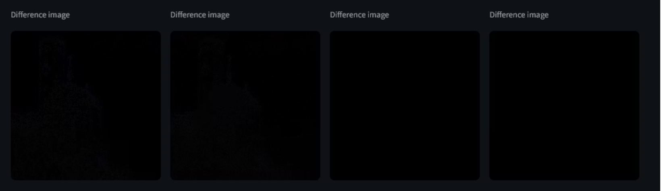
Visualizing Differences
When enabled, a difference image highlights the pixels that changed during compression, offering a clear visual of information loss or alteration.

Slide 12
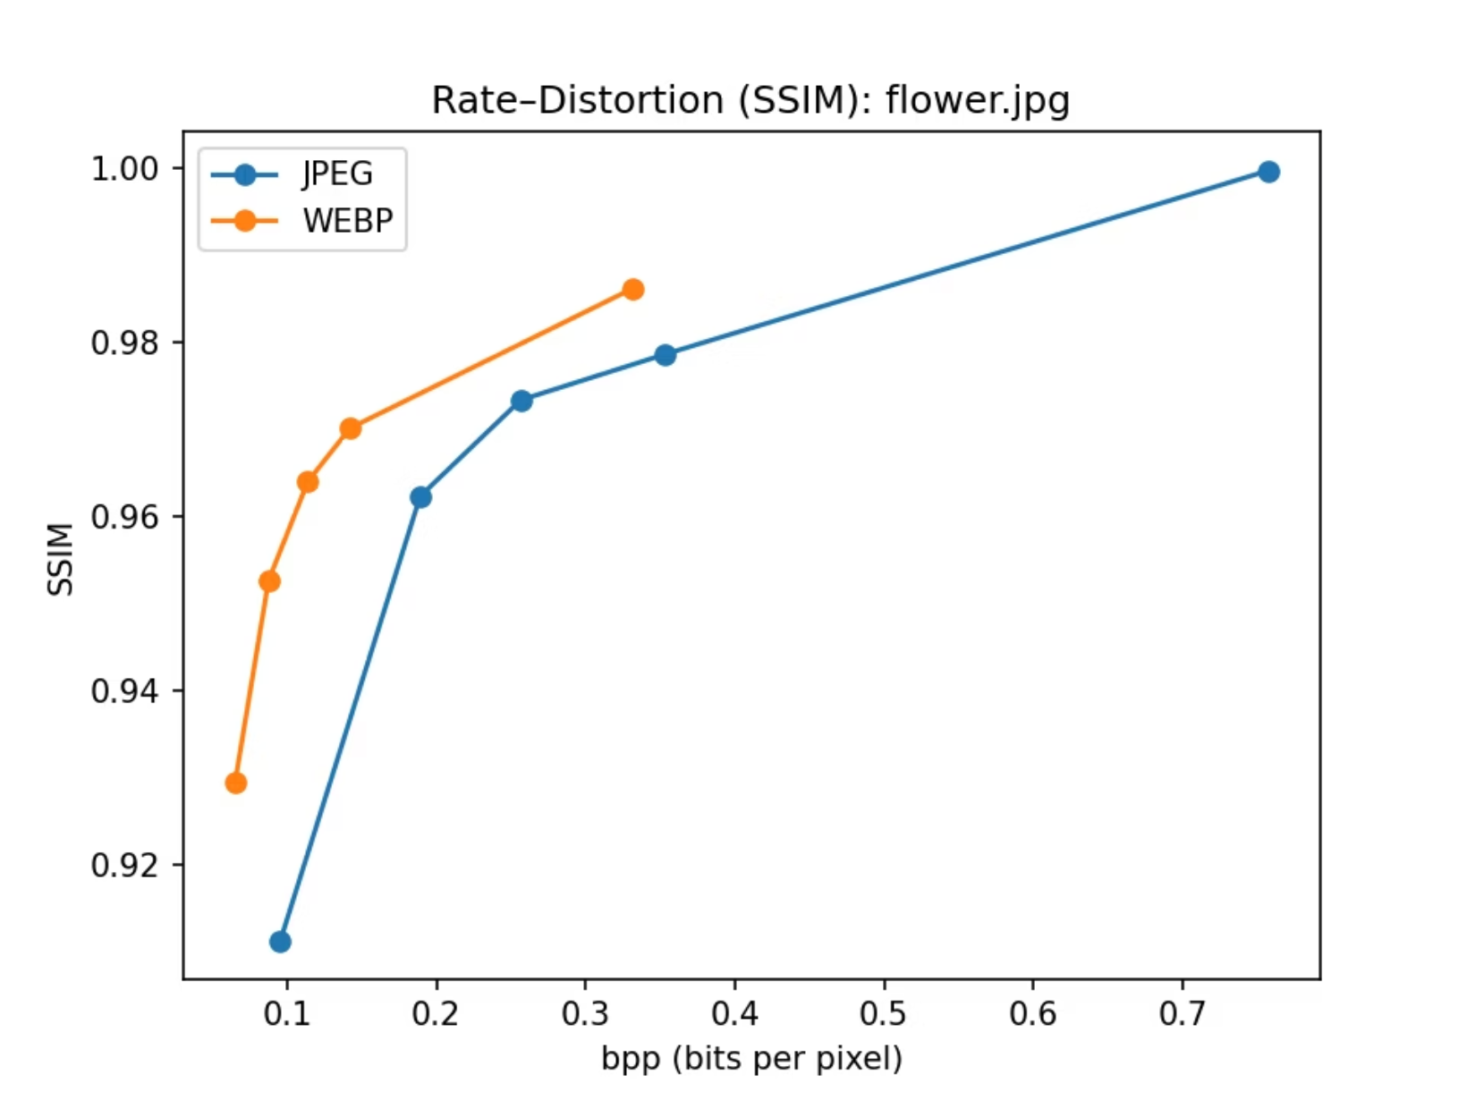
Rate-Distortion Plot Analysis
The Rate-Distortion (RD) plot graphically illustrates the trade-off between compression rate (BPP) and image quality (PSNR).

Slide 13




Future Improvments
Integration of AI-Based Image Compression
A major future enhancement is the integration of learned image compression techniques based on deep neural networks
Use of Advanced Perceptual Quality Metrics
Future versions of the system can include advanced perceptual metrics such as MS-SSIM, LPIPS, and VIF
Optimization and Metric-Driven Analysis
Another improvement is to perform metric-driven optimization, where compression parameters are selected based on perceptual quality thresholds rather than fixed quality factors.

